Slide 1


Slide 2

The Open-Closed Principle (OCP)
“The critical design tool for software development
is a mind well educated in design principles”

Slide 3
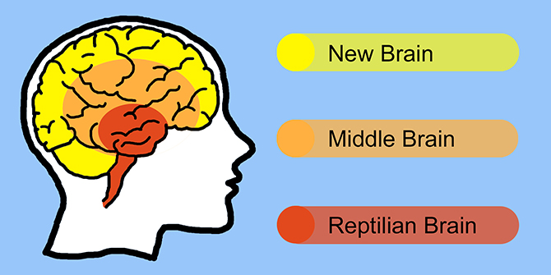
The SOLID acronym
The SOLID acronym is composed of the first letters of 5 design principles:
S Single Responsibility Principle (SRP)
O Open Closed Principle (OCP)
L Liskov’s Substitution Principle (LSP)
I Interface Segregation Principle (ISP)
D Dependency Inversion Principle (DIP)
In SW4SWD
SOLID goes here!

Slide 4

The Open-Closed Principle (OCP)

Slide 5
The Open-Closed Principle (OCP)
Software entities should be open for extension but closed for modification
The Open-Closed Principle (OCP) helps us develop software that can handle changing requirements in the future.
…and software that is testable, and extensible, and easy to comprehend, and…
Let’s have a look…

Slide 6
OCP dissected
Software entities should be open for extension but closed for modification
“Open for extension”: You should expect requirements to change, and allow this change to be implemented through extension of the existing design.
“Closed for modification”: When the requirements calls for extension of your code, it should not be necessary to modify the existing implementation of the clients.

Slide 7
The OCP dialog
You want to implement changes, but without changing things?
Basically, yes…
WTF? Implementing changes without changing stuff?!?
Yes. Implementing changes do no necessarily mean “changing”. It often means “extending”.
Sigh…
Here, let me show you…

Slide 8
Text Editor without OCP
TEXT EDITOR REQUIREMENTS SPECIFICATION, rev. 1.0
…
REQ 27: The Text Editor shall support YeOlePrinter for printing the current text on paper
…
…
TextEditor::TextEditor()
{
printer = new YeOlePrinter()
}
void TextEditor::OnButtonPrint()
{
for each char c in currentText:
printer.printChar(c)
}
void YeOlePrinter::printChar(char c)
{
// Whatever it takes to put ‘c’ on paper
}

Slide 9
Text Editor without OCP
TEXT EDITOR REQUIREMENTS SPECIFICATION, rev. 2.0
…
REQ 27: The Text Editor shall support YeOlePrinter for printing the current text on paper
REQ 27: The Text Editor shall support TheNewPrinter for printing the current text on paper
…
Note how TextEditor has to change to support requirements for new printer
→ TextEditor not closed for modifications
→ TextEditor violates OCP!
TextEditor::TextEditor()
{
printer = new TheNewPrinter()
}
void TextEditor::OnButtonPrint()
{
for each line l in currentText:
printer.printLine(l)
}
TextEditor::TextEditor()
{
printer = new YeOlePrinter()
}
void TextEditor::OnButtonPrint()
{
for each char c in currentText:
printer.printChar(c)
}
void TheNewPrinter::printLine(char l)
{
// Whatever it takes to put ‘l’ on paper
}
void YeOlePrinter::printChar(char c)
{
// Whatever it takes to put ‘c’ on paper
}

Slide 10
The OCP newbie dialog II
Damn…what went wrong? I didn’t want to change TextEditor, only the printer it uses!
TextEditor was too tightly coupled to Printer, therefore extensions to the printer used rippled through –TextEditor was not closed for modifications when changes were needed…
But how could I ever avoid that? It is a whole new printer I am trying to use. And what if the supported printer is changed again? Or if we need to support several printers?
We could apply OCP and make TextEditor open for extension (the new printer or printers) but closed for modifications…let me show you!

Slide 11
Text Editor with OCP
TEXT EDITOR REQUIREMENTS SPECIFICATION, rev. 1.0
…
REQ 27: The Text Editor shall support YeOlePrinter for printing the current text on paper
…
…
Hmm…this looks likely to change in the future. I am going to apply OCP!
TextEditor::TextEditor(IPrinter p)
{
printer = p
}
void TextEditor::OnButtonPrint()
{
printer.printText(currentText)
}
void YeOlePrinterDriver::printText(text t)
{
for each char c in t:
printChar(c);
}
void printChar(char c)
{
// Whatever it takes to put ‘c’ on paper
}

Slide 12
Text Editor with OCP
TEXT EDITOR REQUIREMENTS SPECIFICATION, rev. 2.0
…
REQ 27: The Text Editor shall support YeOlePrinter for printing the current text on paper
REQ 27: The Text Editor shall support TheNewPrinter for printing the current text on paper
…
Ha! I knew it! Salesmen are bastards! Good thing I had OCP in place…
Note how TextEditor did not change to use the new printer
→ TextEditor closed for modifications
→ TextEditor adheres to OCP!
TextEditor::TextEditor(IPrinter p)
{
printer = p
}
void TextEditor::OnButtonPrint()
{
printer.printText(currentText)
}
void TheNewPrinterDriver::printText(text t)
{
for each line l in t:
printLine(l);
}
void TheNewPrinterDriver::printLine(line l)
{
// Whatever it takes to put ‘l’ on paper
}

Slide 13

A final word of caution

Slide 14

Questions?

